Slide 1

Time Series and Financial Time Series Project
Group members:
Silvia Adaggio
Beatrice Saccucci
Paolo Manenti
Alessandro Lanzo
2011167
1786623
1999957
1995464

Slide 2
Table of Contents
Backtesting
Application
Introduction
Descriptive
Statistics
MCS results
Models
Conclusions

Slide 3
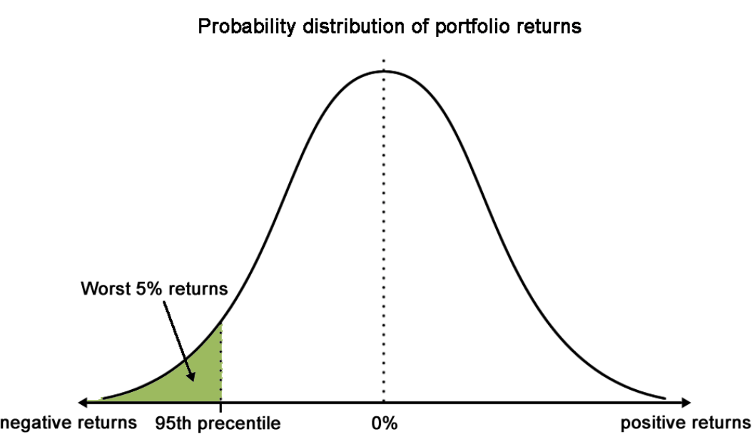
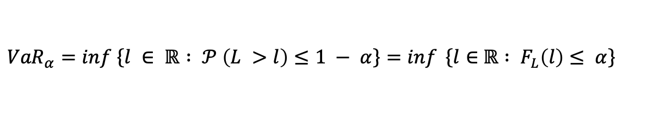
Value at Risk
It can be defined as a risk measure that estimates the maximum loss that is not exceeded with a given probability, by holding a certain financial asset with respect to a determined confidence interval and a target horizon.
$${VaR}_{α}=\inf\left\{l ∈ ℝ : 𝒫 \left(L >l\right)≤1 − \left.α\right\}\right.=\inf{ \left\{l∈ \right.ℝ : F_{L}\left(l\right)≤ \left.α\right\}}$$
Methods:
Historical
Montecarlo
Variance - Covariance
Goals:
Reporting
Risk management
Measuring the investment risks

Slide 4


Models Specification
GARCH - Generalized AutoRegressive Conditional Heteroskedasticity
This class of models is mostly used for financial data given their ability to catch heteroskedasticity and volatility clustering. The simplest form is:
Limit: inability to catch the higher impact of negative shocks on the volatility (leverage effect)
$$σ_{t}^{2}=ω+αε_{t−1}^{2}+βσ_{t−1}^{2}$$
eGARCH - Exponential Generalized AutoRegressive Conditional Heteroskedasticity
It represents an extension of the GARCH which responds in an asymmetric way to positive and negative shocks, showing the impact of those on the variability.
${log⁡(σ}_{t}^{2})=ω+αg\left(ε_{t−1}\right)+ β{log⁡(σ}_{t−1}^{2}$)

Slide 5
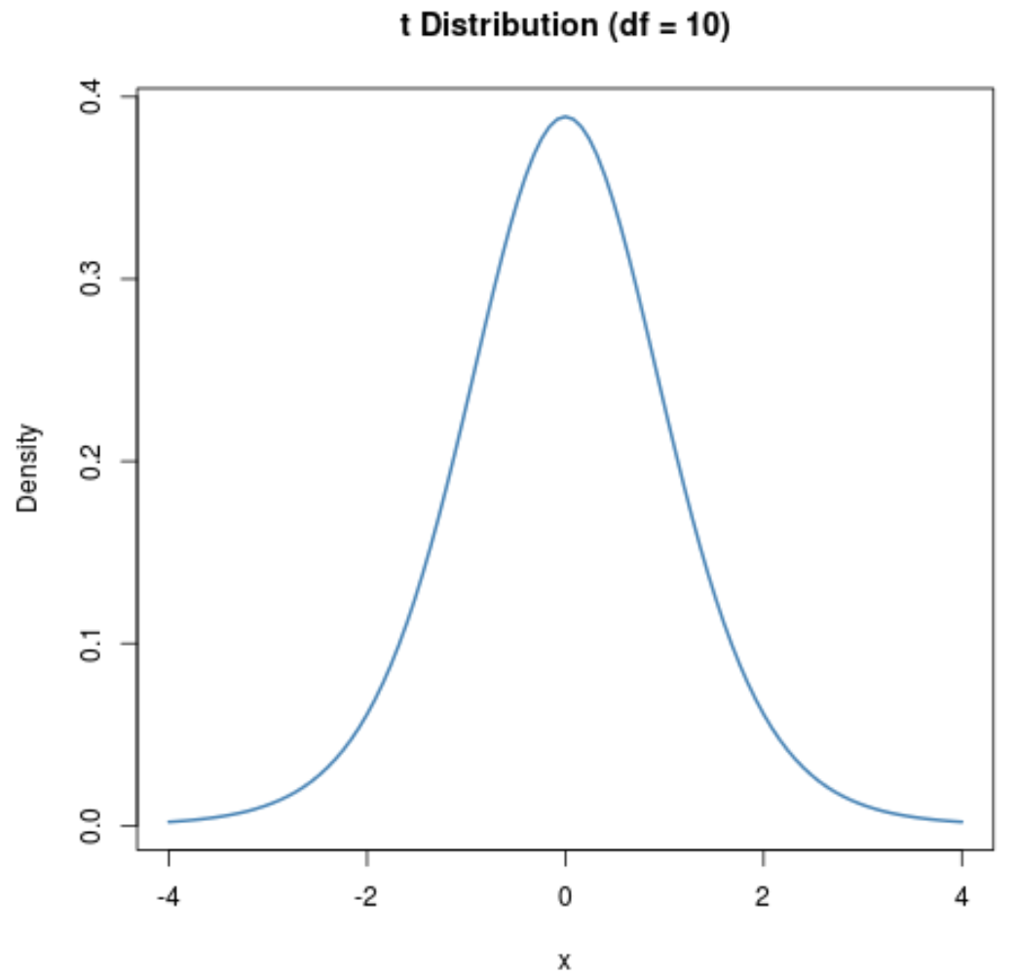
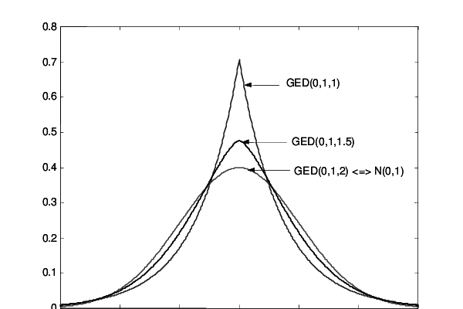
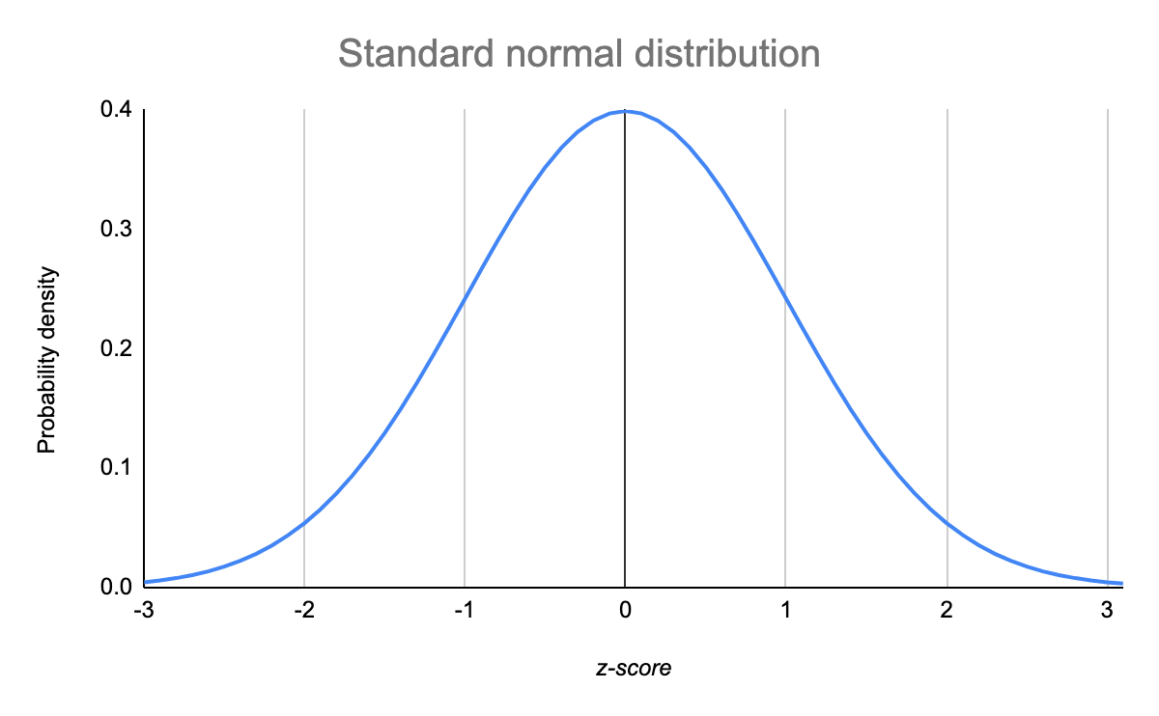
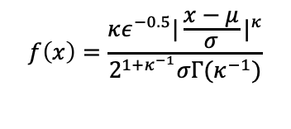
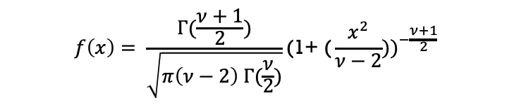

Distribution specification
Normal
Student-t
GED
$$f\left(x\right)= \frac{1}{σ\sqrt{2π}}e^{−\frac{1}{2}{\left(\frac{z − μ}{σ}\right)}^{2}}$$
$$f\left(x\right)= \frac{Γ(\frac{ν+1}{2})}{\sqrt{π\left(ν−2\right) Γ(\frac{ν}{2})}}{\text{(1+ (}\frac{x^{2}}{ν−2}))}^{−\frac{ν+1}{2}}$$
$$f\left(x\right)=\frac{κε^{−0.5}{|\frac{x−μ}{σ}|}^{κ}}{2^{{1+κ}^{−1}}σΓ(κ^{−1})}$$

Slide 6


Data
WTI
Eu brent
Heating Oil
propane
The first part of the analysis is developed from February 28th 2020 to June 4th 2021 considering the daily closing prices of the above commodities with 316 observations.
The second part includes a weekly frequency variable: Covid-19 deaths in USA in 68 weeks that go from March 2nd 2020 to June 14th 2021

Slide 7

GARCH - MIDAS
The model aims to explore the presence and the influence of macroeconomic series onto VaR estimation. The regressors can have different level of frequency among them and with respect to the dependent variable.
Low frequency data
High frequency data
$$r_{i,t}= \sqrt{τ_{t}g_{i,t}ε_{i,t}}$$
The parameter of interest θ (Covid-19 deaths) is included in $τ_{t},$ that represents the long run component.

Slide 8
Data manipulation
Stationarity verification
01
Prices transformation
02
Graphical analysis
03
Normality tests
04
Graphical normality test
05

Slide 9
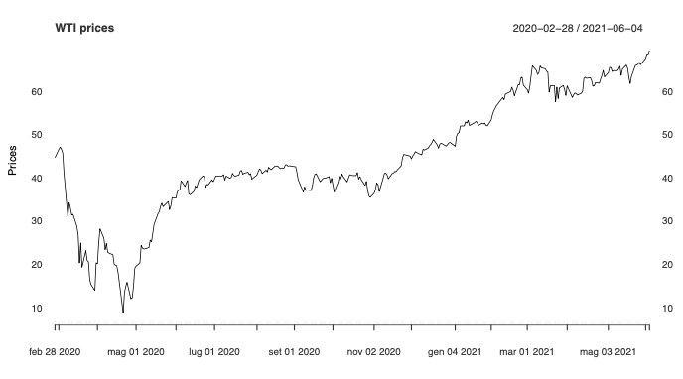
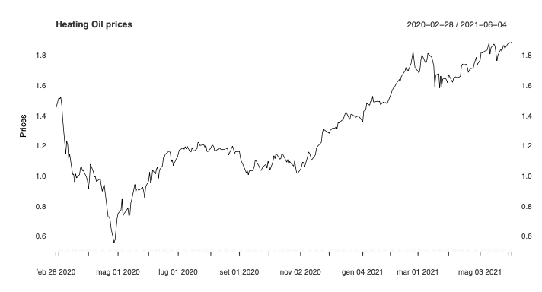
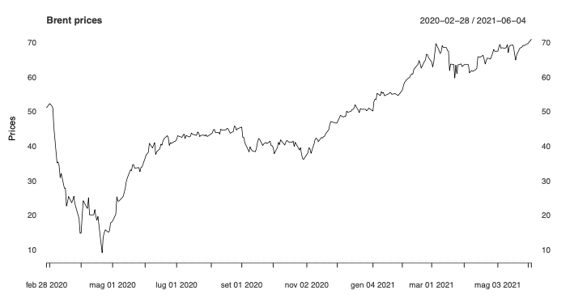
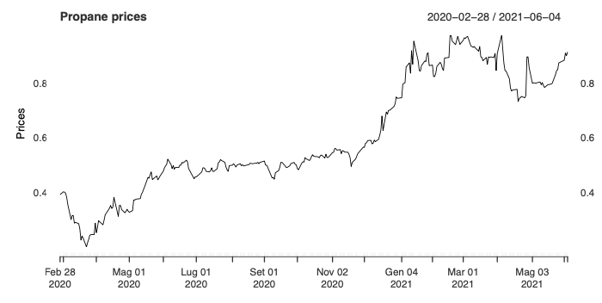
Stationarity verification - 1

Slide 10
Stationarity verification - 2

Slide 11
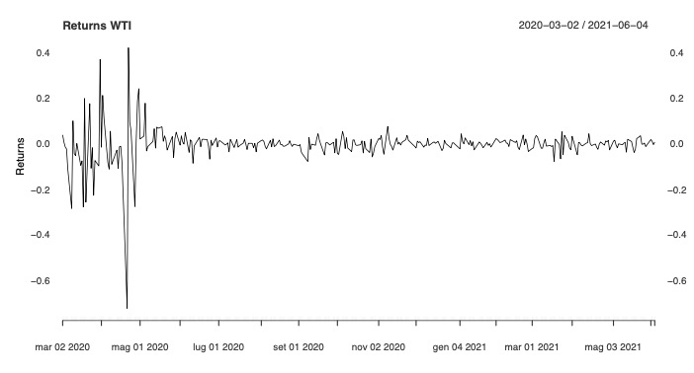
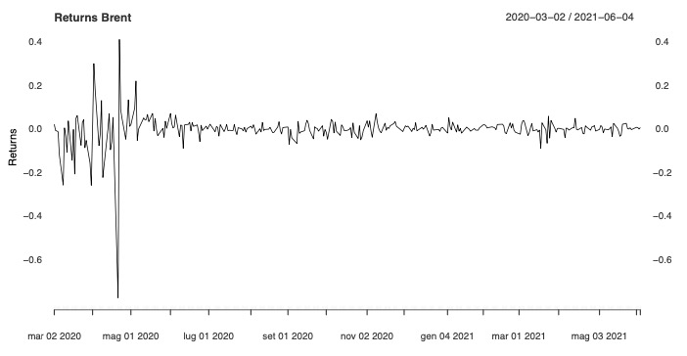
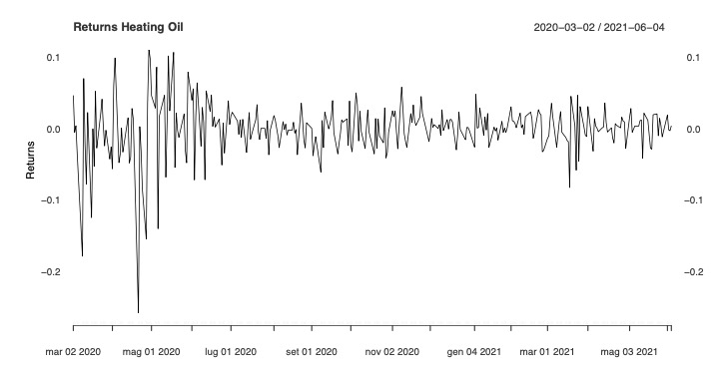
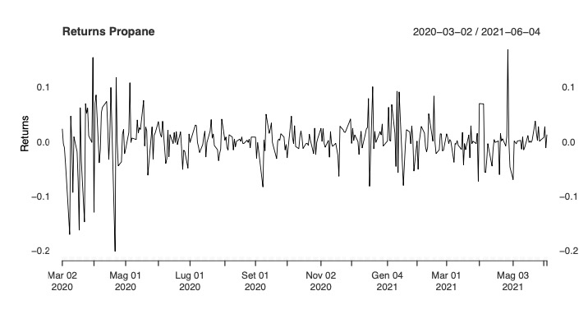

Prices transformation
In order to obtain stationary series, we have firstly computed the logarithms and then the first order differences between them.
Through this procedure we are able to calculate the return of the prices.
$$r_{t}=\log_{pt}{−\log_{pt−1}}$$

Slide 12
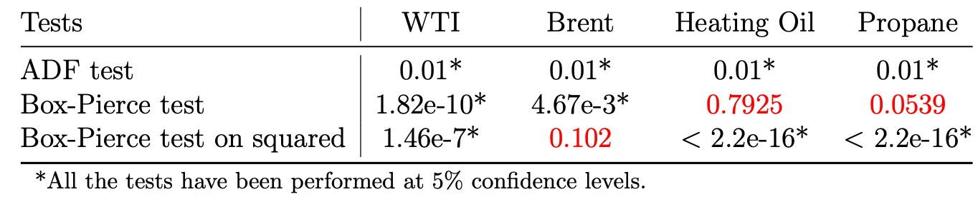
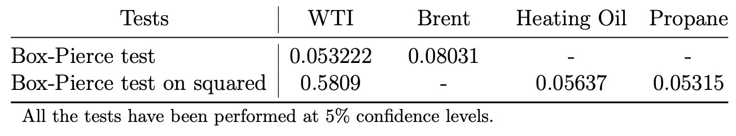
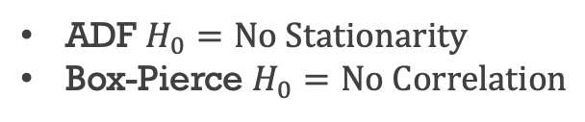
Stationarity tests
With the following results, the stationarity of the series is confirmed. Although the data manipulation previously mentioned, some results do not reject the null hypothesis at lag = 35. For this reason, we go on with the analysis computing again the Box-Pierce test with different values of lags.
ADF $H_{0}=No Stationarity$
Box-Pierce $H_{0}=No Correlation$
WTI at lag = 100
Brent at lag = 50

Slide 13
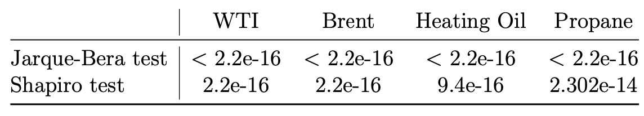
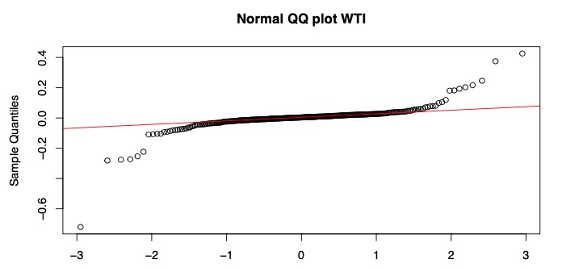
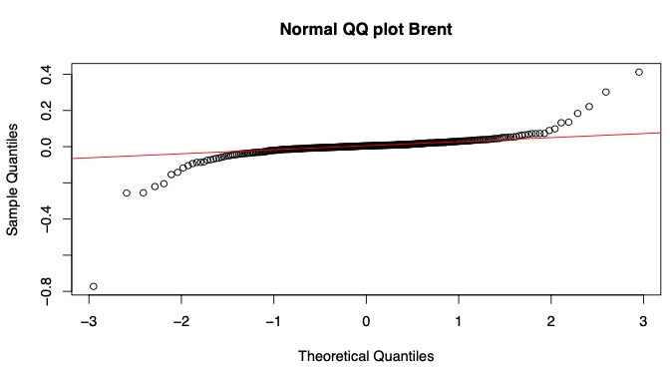
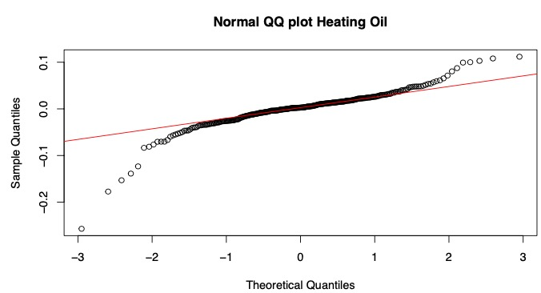
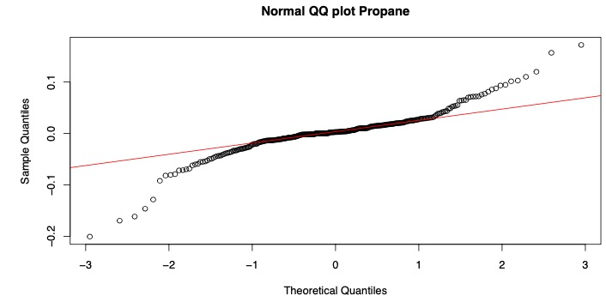
Normality test and graphical analysis
What emerges is that none of the commodities has a normal distribution for the residuals. Both of the Jarque-Bera and Shapiro test consider the null hypothesis as the normality, that must be not rejected for a p-value > 5%.

Slide 14
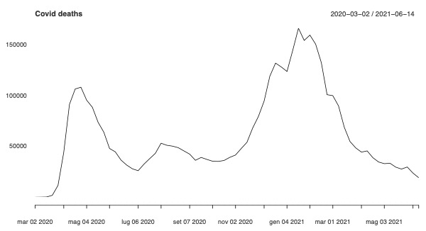
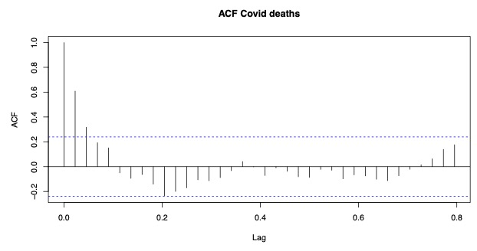
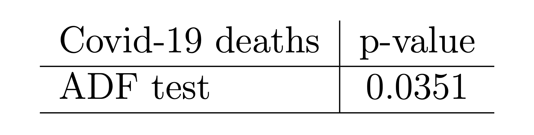
Covid-19 analysis
To pursue the aim of the project, after the preliminary analysis on the four different commodities, we checked the stationarity in the weekly frequency variable. Given some irregular evolutions, we computed the first order differences so that the series would become stationary.
At 5% the null hypothesis is rejected

Slide 15
VaR estimation strategy
The estimated VaR, computed at 95% and 99% confidence level, has been calculated by dividing the sample in two parts:
In-sample data
Out-of-sample data
165 observations
150 observations
The function of the in-sample data is to estimate the out-of-sample part.

Slide 16

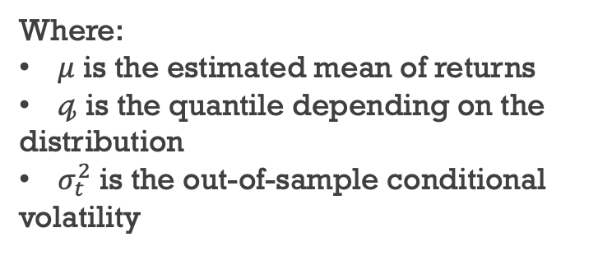
VaR methodologies
1
3
4
5
…
166
2
168
167
169
170
GARCH MIDAS
GARCH
Main features:
Refit window: “moving”
Refit every: 5 step ahead forecast
6
8
9
10
…
171
7
173
174
175
172
Consequently to the estimation of the GARCH-MIDAS models, we are intersted in the out-of-sample volatility estimates in order to build the formula of the VaR.
Normal and Student t distibution
146
148
149
150
…
311
147
313
314
315
312
$VaR= μ$ + $𝓆\left(τ\right) × σ_{t}^{2}$
.
.
.
Where:
$μ$ is the estimated mean of returns
$𝓆$ is the quantile depending on the distribution
$σ_{t}^{2}$ is the out-of-sample conditional volatility

Slide 17


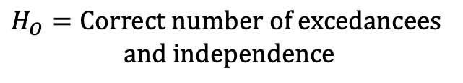
Backtesting procedure
The purpose of backtesting is to compare the ex-post estimated values, that precisesly correspond to on the VaR estimation, to those that have been actually realized, respectively corresponding to the out-of-sample values.
Kupiec (LR.uc)
Christoffersen (LR.cc)
Dynamic Quantile (DQ)
$$H_{O}=Correct number of excedancees$$
$$H_{O}=Correct number of excedancees$$
$$and independence$$
$$H_{O}=Independence of the violations$$
IDEA OF THE PROCEDURE
The models which pass two out of three the above mentioned tests will be admitted to MCS procedure.

Slide 18
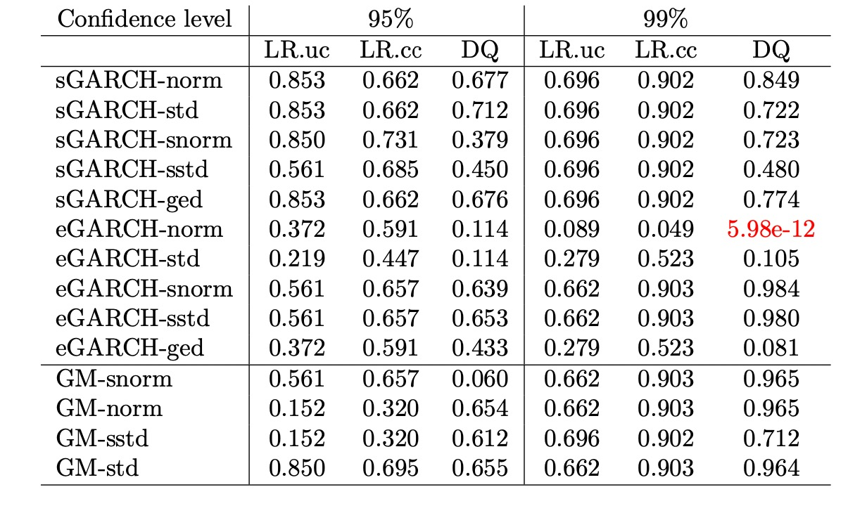
Backtesting application - WTI

Slide 19
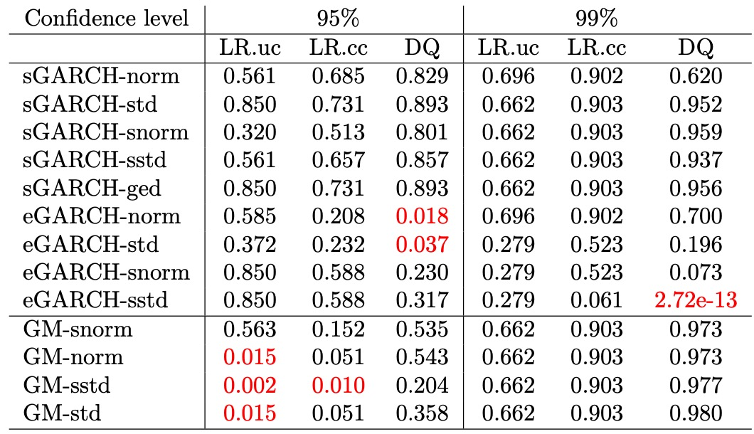
Backtesting application - Brent

Slide 20
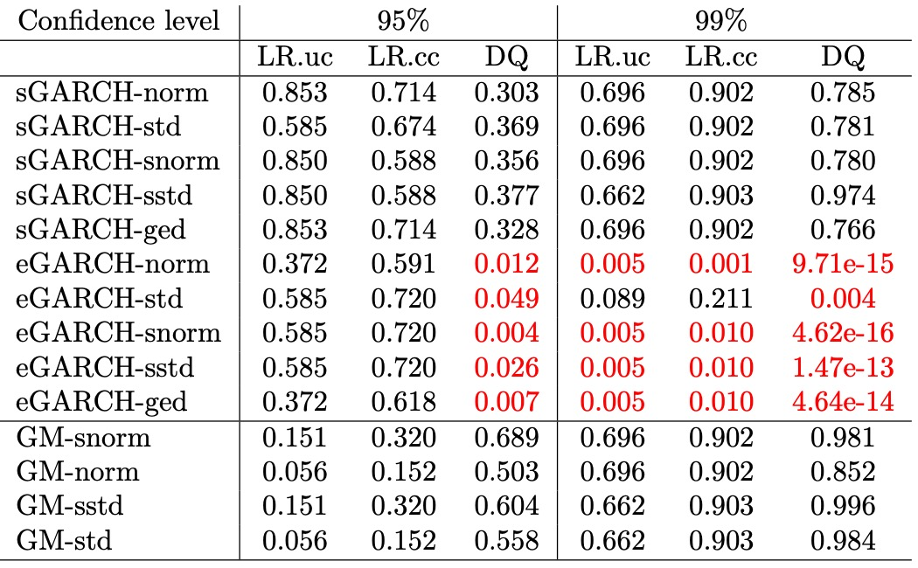
Backtesting application – Heating Oil

Slide 21
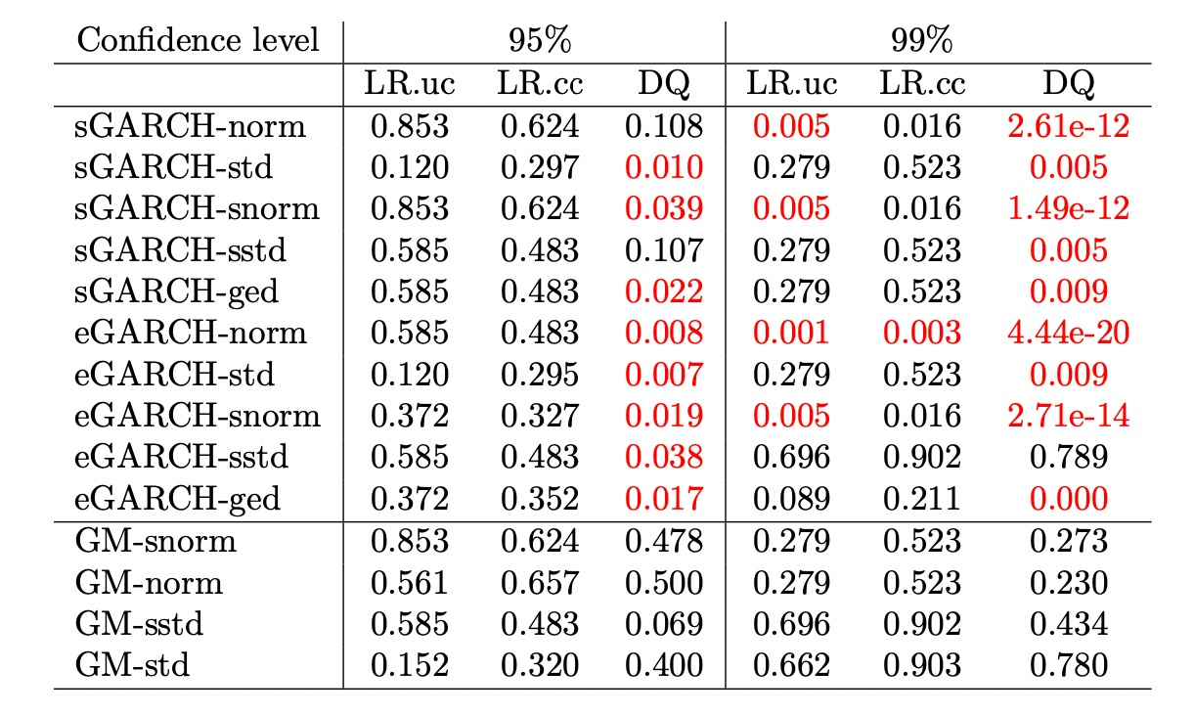
Backtesting application – Propane

Slide 22
Model Confidence Set procedure
Backtesting
VaR
Models estimation
Success
Failure
MCS
Ranked
Eliminated
The best models considered will be the ones that better estimate the VaR. To do so, we apply the MCS procedure: given a certain confidence level, it performs a sequence of statistical tests to construct a subset of superior models with equal predictive ability with respect to an arbitrary loss function.
What we obtain is the Superior Set of Models (SSM), where the scenario we strive for is a final set consisting in one single model. Unfortunately, it is a very rare case, either because of the poor information coming from the data or because the considered models are, instead statistically equivalent.

Slide 23
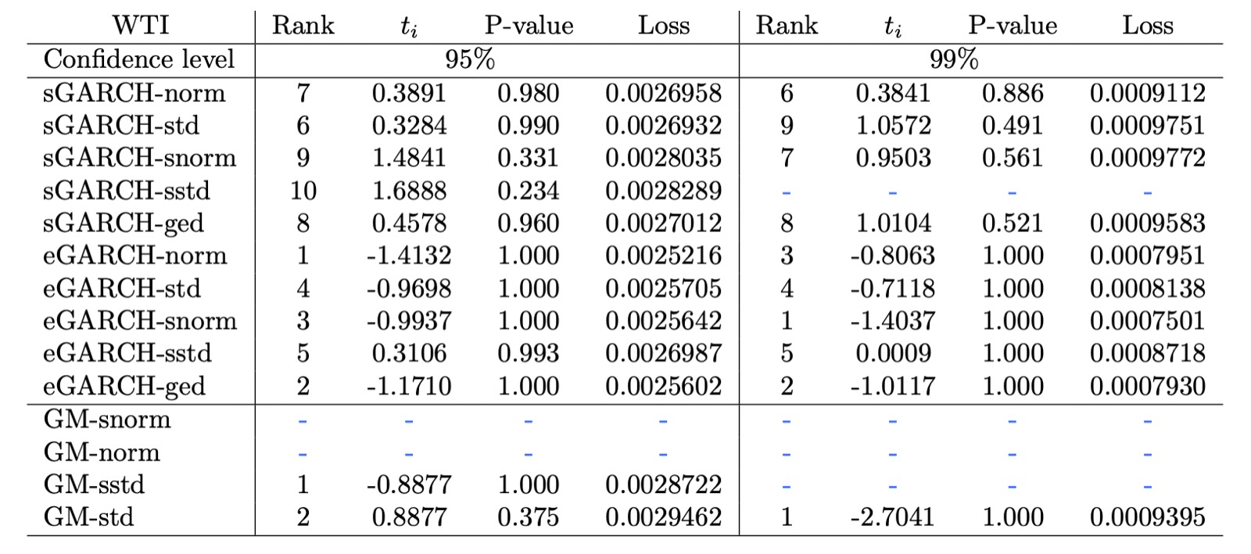
MCS application – WTI

Slide 24
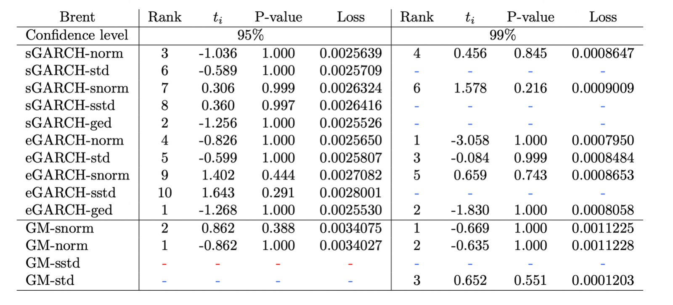
MCS application – Brent

Slide 25
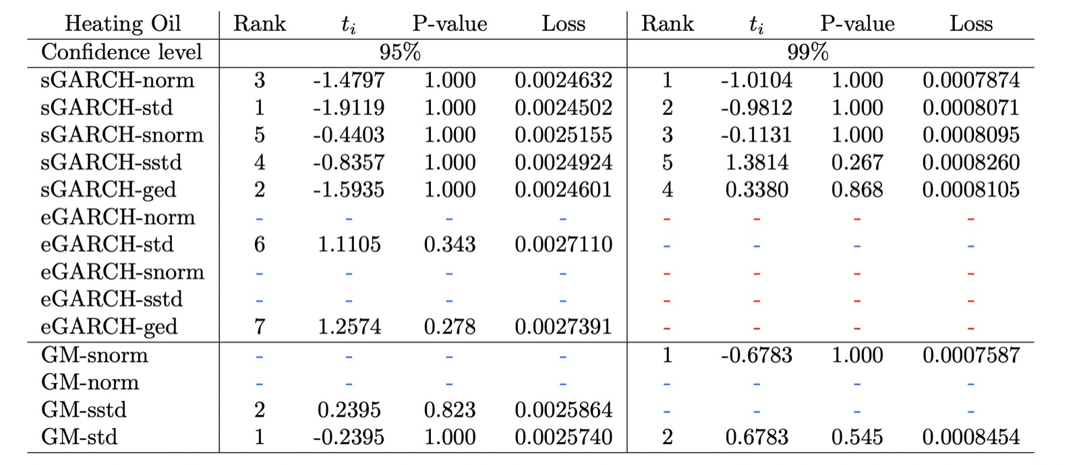
MCS application – Heating Oil

Slide 26
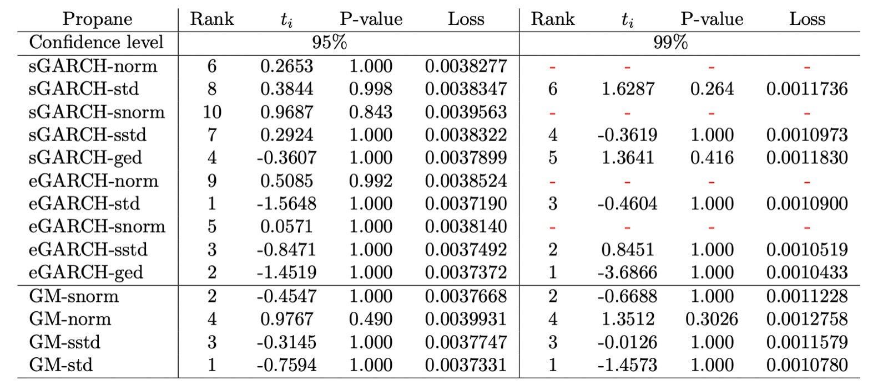
MCS application – Propane

Slide 27
Conclusions

Slide 28
Thanks for the attention!

Slide 29
References
Mila Andreani, Vincenzo Candila, Giacomo Morelli, and Lea Petrella. Multi- variate analysis of energy commodities during the covid-19 pandemic: Evidence from a mixed-frequency approach. Risks, 9(8), 2021.
Mauro Bernardi and Leopoldo Catania. The model confidence set package for r, 2014.
Tim Bollerslev. Generalized autoregressive conditional heteroskedasticity. Jour- nal of Econometrics, 31(3):307–327, 1986.
Vincenzo Candila. rumidas: Univariate GARCH-MIDAS, Double-Asymmetric GARCH-MIDAS and MEM-MIDAS models., 2021. R package version 0.1.1.
Robert F Engle, Eric Ghysels, and Bumjean Sohn. On the economic sources of stock market volatility. In AFA 2008 New Orleans Meetings Paper, 2008.
Eric Ghysels, Pedro Santa-Clara, and Rossen Valkanov. The midas touch: Mixed data sampling regression models. Cirano working papers, CIRANO, 2004.
Peter Reinhard Hansen, Asger Lunde, and James M Nason. Choosing the best volatility models: the model confidence set approach. Oxford Bulletin of Eco- nomics and Statistics, 65:839–861, 2003.
Glyn A Holton. History of value-at-risk, 2002.
Philippe Jorion. Risk2: Measuring the risk in value at risk. Financial Analysts Journal, 52(6):47–56, 1996.
Alessandro G. Laporta, Luca Merlo, and Lea Petrella. Selection of value at risk models for energy commodities. Energy Economics, 74:628–643, 2018.
Daniel B. Nelson and Charles Q. Cao. Inequality constraints in the univariate garch model. Journal of Business & Economic Statistics, 10(2):229–235, 1992.
A. O’Hagan and Tom Leonard. Bayes estimation subject to uncertainty about parameter constraints. Biometrika, 63(1):201–203, 1976.
Simona Roccioletti. Backtesting Value at Risk and Expected Shortfall. Springer Fachmedien Wiesbaden, 2016.

